Slide 1
Drive Systems
Presented By:
Ben Heaivilin – Lead Advisor: Team 1764 (5 years)
Jon Nelson – Mentor; Industrial Engineer - Honeywell
Rachel Lindsay – Student Team 1764

Slide 2
Overview
Importance
Fundamental Considerations
Types of Drive Systems
Traction
Power and Power Transmission
Practical & Realistic Considerations
Credits

Slide 3
Importance
The best drive train…
is more important than anything else on the robot
meets your strategy goals
can be built with your resources
rarely needs maintenance
can be fixed within 4 minutes
is more important than anything else on the robot

Slide 4
Fundamental Considerations
Know your resources
Cost, Machining Availability, Parts, Expertise, etc
Keep it simple (KISS)
Easy to design and build
Gets it up and running quicker
Easier to fix
Get it Running
Find out what is wrong
Practice for Driving
Time for Fine-Tuning
Give software team TIME to work

Slide 5
Types of Drive Train
Drive Train Decision Depends on:
Team Strategy
Attributes needed
Speed, Power, Pushing, Climbing, Maneuverability, Acceleration, Accuracy, Obstacle Handling, Reliability, Durability, Ease of Control
Resources available
Must sacrifice some attributes for others. No one system will perform all the above functions

Slide 6
Good Features to have to attain proper attributes
High Top Speed
High Power
High Efficiency/Low Losses
Correct Gear Ratio
Acceleration
High Power
Low Inertia
Low Mass
Correct Gear Ratio
Pushing/Pulling
High Power
High Traction
High Efficiency/Low Losses
Correct Gear Ratio
Obstacle Handling
Ground Clearance
Obstacle "Protection”
Drive Wheels on Floor
Accuracy
Good Control Calibration
Correct Gear Ratio
Climbing Ability
High Traction
Ground Clearance
Correct Gear Ratio
Reliability/ Durability
Simple
Robust
Good Fastening Systems
Ease of Control
Intuitive Control
High Reliability
Maneuverability
Good Turning Method

Slide 7
What types of Drives are Available?
2 Wheel Drive
4 Wheel Drive with 2 Gearboxes
4 Wheel Drive with 4 Gearboxes
6 Wheel Drive with 2 Gearboxes
Tank Drive and Treads
Omni-directional Drive Systems
Mecanum
Holonomic / Killough
Crab/Swerve
Other

Slide 8
Usage in FRC?
2008 Championship Division Winners and Finalists
14 Six Wheel drive
2 Six Wheel with omni’s
2 Four wheel with omni’s
2 Mecanum
2 Swerve/Crab drive
1 Four wheel rack and pinion!
Remember: Drives Game Dependent

Slide 9
DRIVE SYSTEMS

Slide 10
2 Wheel Drive
Pros (+)
Easy to Design
Easy to Build
Light Weight
Inexpensive
Agile
Easy Turning
Fast
COTS Parts
Cons (-)
Not Much Power
Does not do well on ramps
Poor Pushing
Susceptible to spin outs.
Able to be pushed from the side
Driven Wheels
Gearbox
Gearbox
Motors can be driven in front or rear
Position of Driven Wheels:
Near Center of Gravity
for most traction
Front Drive for Max
Positioning
3) Lose Traction if weight not over wheels
Caster
or
Omni

Slide 11
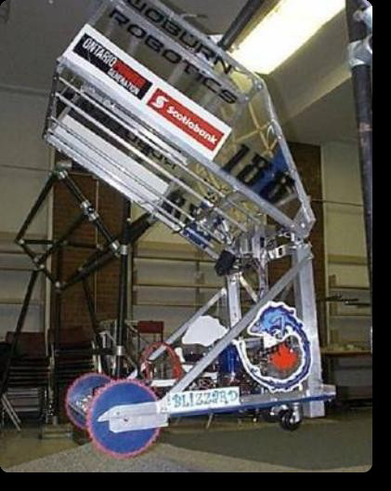
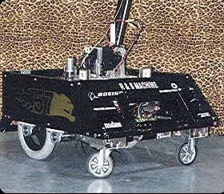
2 Wheel Drive: Examples

Slide 12
4 Wheel Drive – 2 Gearboxes (AKA Tank Drive – no treads)
Driven Wheels
Pros (+)
Easy to Design
Easy to Build
More Powerful
Sturdy and stable
Wheel Options
Omni, Traction, Other
COTS Parts
Cons (-)
Not Agile
Turning can be difficult
Adjustment Needed
Slightly Slower
Gearbox
Gearbox
Position gearboxes anywhere as needed for mounting and center of gravity
Position of Wheels:
Close together = better turning
Spread Apart = Straighter driving
Chain or belt
Driven Wheels

Slide 13
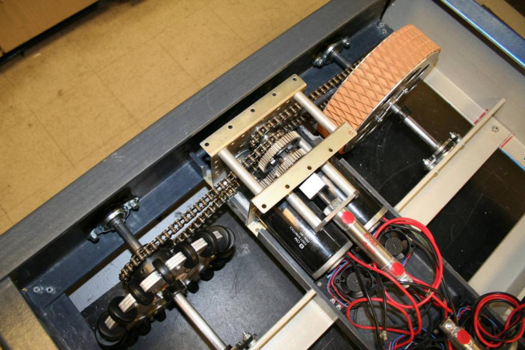
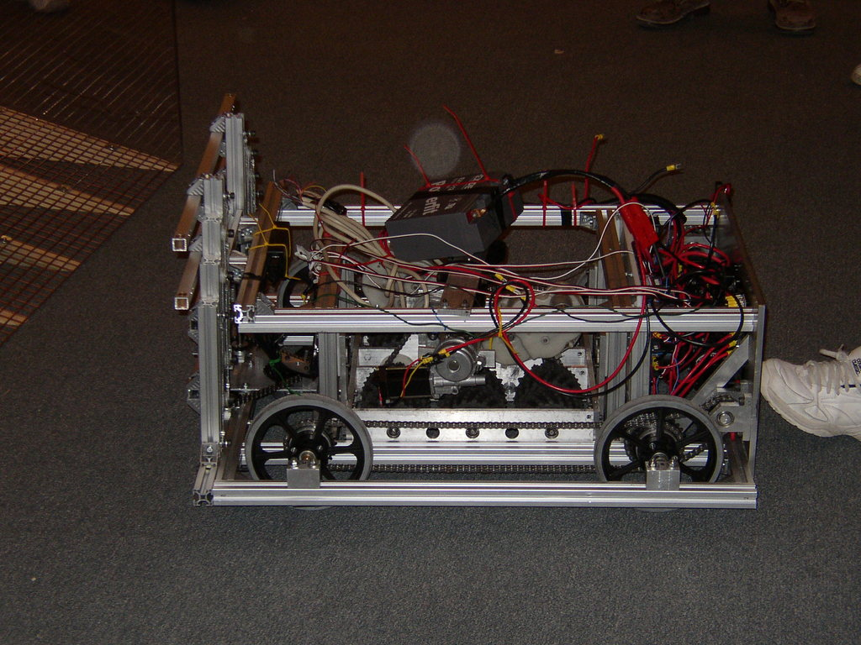
4 Wheel Drive – 2 Gearbox : Examples

Slide 14
4 Wheel Drive – 4 Gearboxes
Driven Wheels
Pros (+)
Easy to Design
Easy to Build
Powerful
Sturdy & Stable
Many Options
Mecanum, Traction, Omni, Combo
COTS Parts
Cons (-)
Heavy
Costly
Turning may or may not be difficult
Options
4 traction
+ Pushing, Traction, Straight
- Turning
All Mecanum; 2 traction & 2 Omni
+ Mobility
- Less traction, Less pushing
Gearbox
Gearbox
Types of wheels determine whether robot has traction, pushing ability, and mobility
If all traction wheels, keep wheel base short; difficult to turn.
Driven Wheels
Gearbox
Gearbox

Slide 15
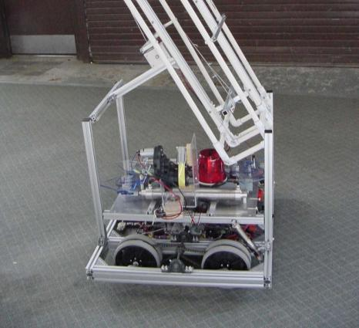
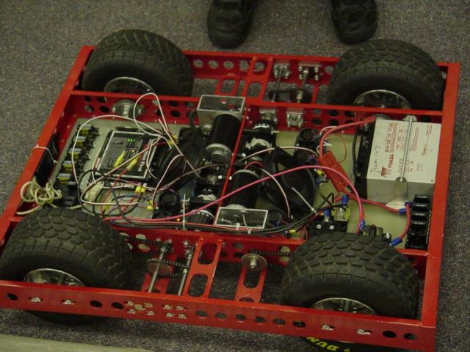
4 Wheel Drive – 4 Gearboxes: Examples

Slide 16
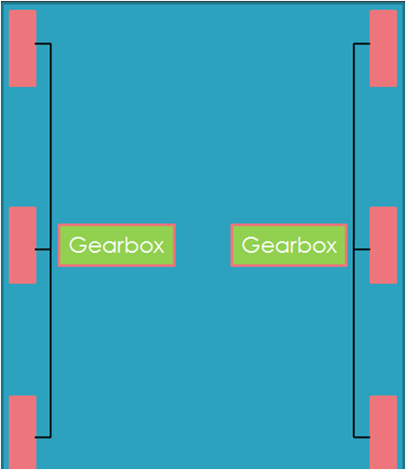
6 Wheel Drive – 2 Gearboxes
Pros (+)
Easy to Design & Build
Powerful
Stable
Agile
Turns at center of robot
Pushing
Harder to be high Centered
COTS Parts
Cons (-)
Heavy & Costly
Turning may or may not be difficult
Chain paths
Optional
Substitute Omni Wheel sets at either end
Traction: Depends on wheels
Pushing = Great w/ traction wheels
Pushing = Okay w/ Omni
2 Ways to be agile:
Lower Contact on Center Wheel
Omni wheels on back, front or both
Center wheel generally larger or lowered 1/8” - 1/4”
Rocking isn’t too bad at edges of robot footprint, but can be significant at the end of long arms and appendages
This is the
GOLD STANDARD
for FIRST

Slide 17
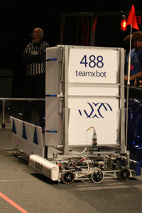
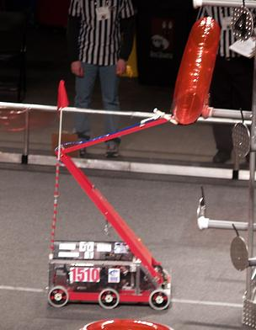
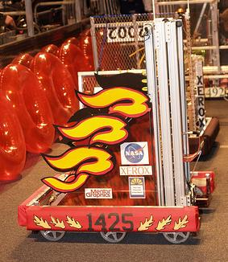
6 Wheel Drive - 2 Gearboxes Examples

Slide 18
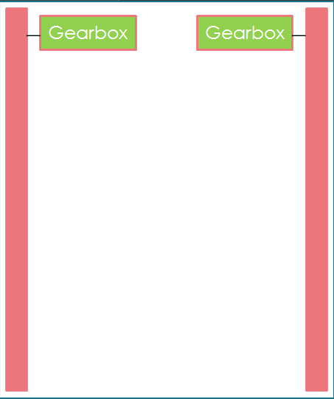
Tank Drive/Treads
Pros (+)
Climbing Ability
(best attribute)
Great Traction
Turns at Center
Pushing
Very Stable
Powerful
Cons (-)
Energy Efficiency
Mechanical Complexity
Difficult for student build teams
Turns can tear off treads
WEIGHT
Expensive
Repairing broken treads.
Lower track at center slightly to allow for better turning.

Slide 19
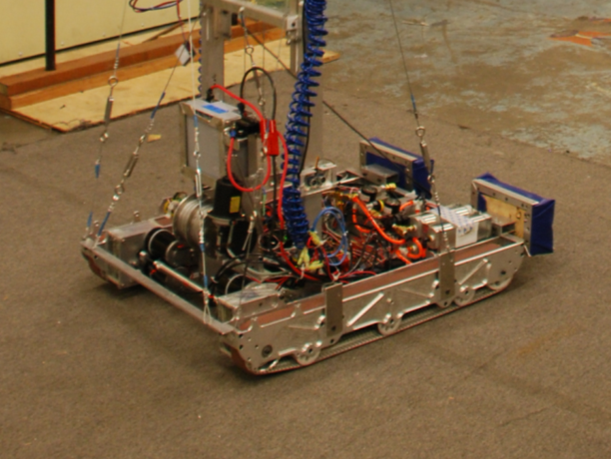
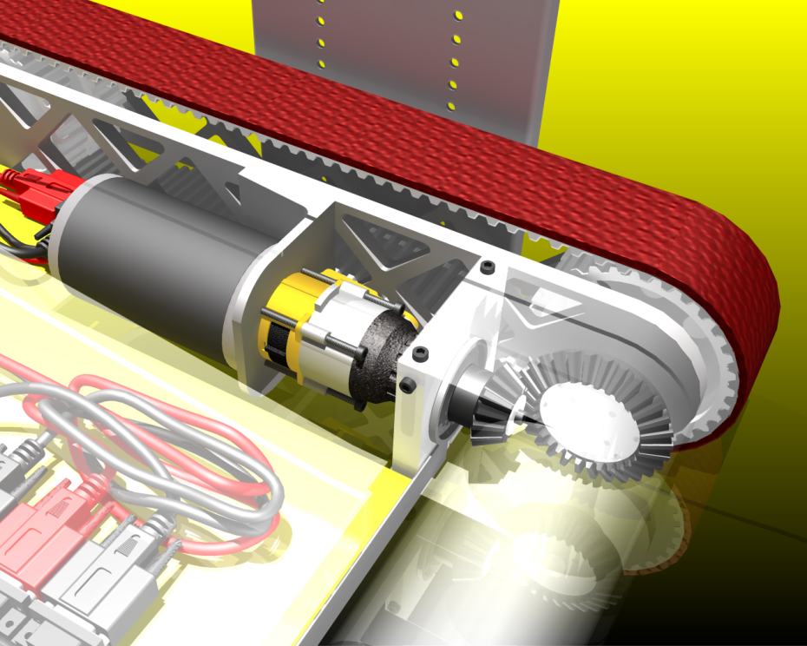
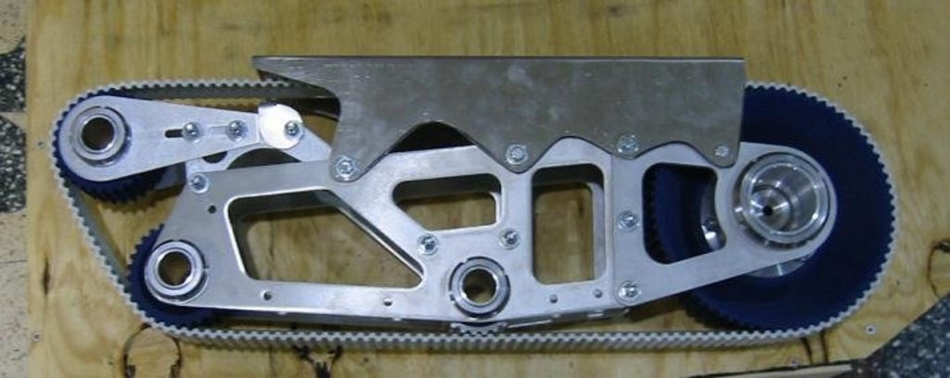
Tank Drive/Treads Examples

Slide 20
Omni-directional drives
“Omnidirectional motion is useless in a drag race… but GREAT in a mine field”
Remember, task and strategy determine usefulness

Slide 21
Omni: Mecanum
Pros (+)
Simple Mechanism
High Maneuverability
Immediate Turn
Simple Control
4 wheel independent
Simple mounting and chains
Turns around Center of robot
COTS Parts
Cons (-)
Braking Power
OK Pushing
Suspension for teeth chattering
Inclines
Software complexity
Drift (uneven weight distribution)
Expense
Motor(s)
Motor(s)
For best results, independent motor drive for each wheel is necessary.
Motor(s)
Motor(s)

Slide 22
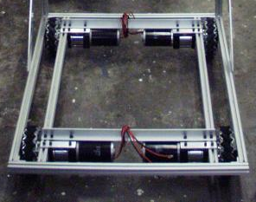
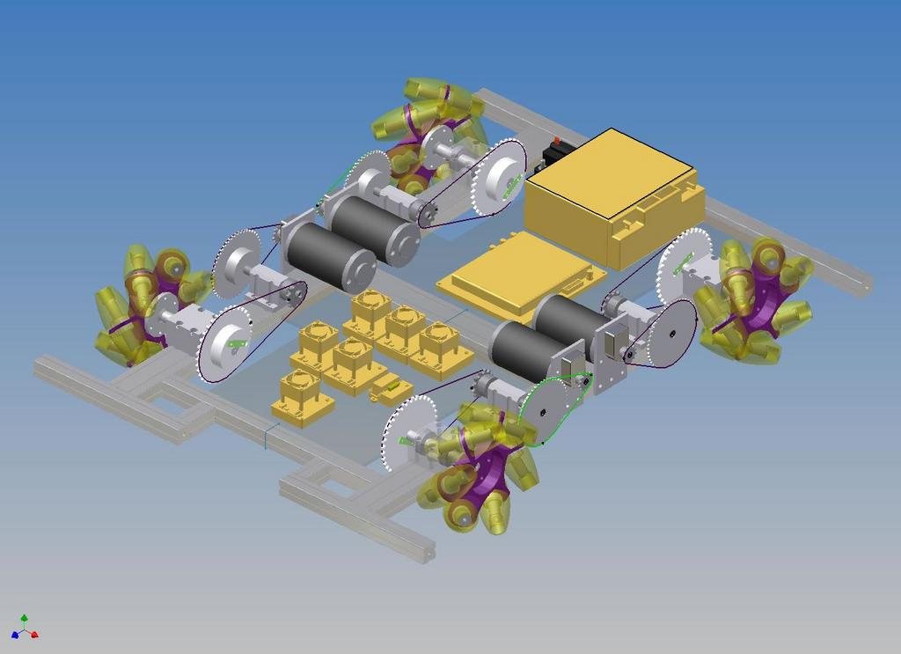
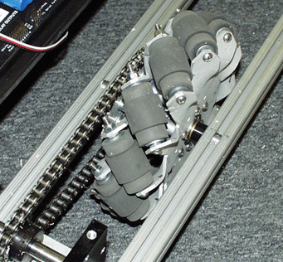
Omni: Mecanum Examples

Slide 23
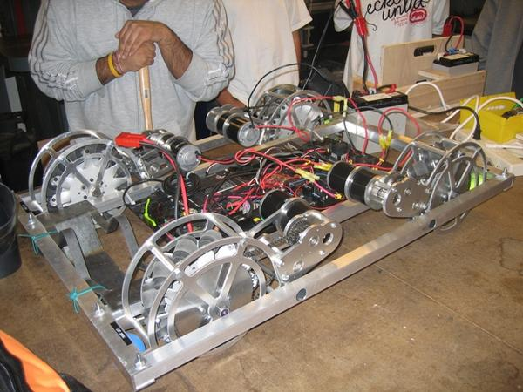
Omni: Mecanum Examples

Slide 24
Omni: Mecanum Examples
http://www.youtube.com/watch?v=xgTJcm9EVnE

Slide 25
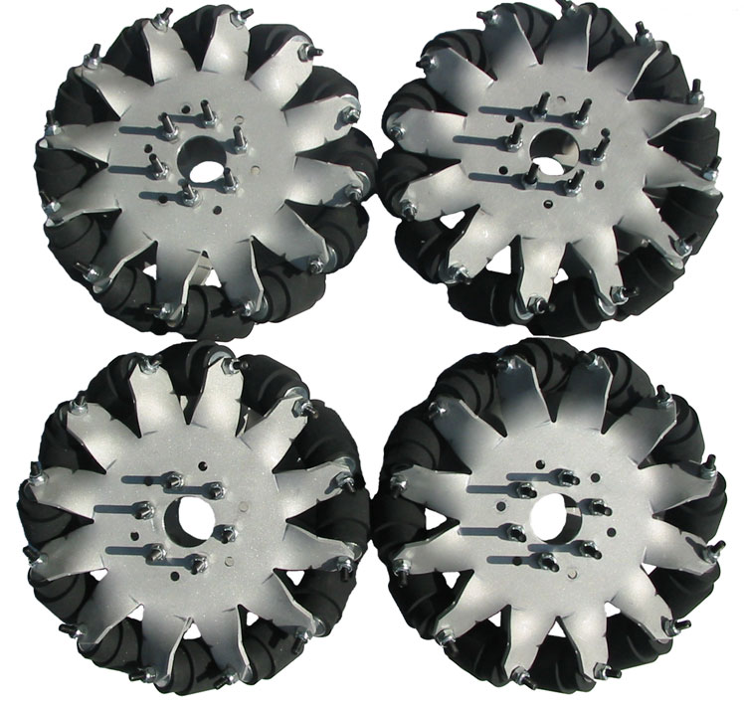
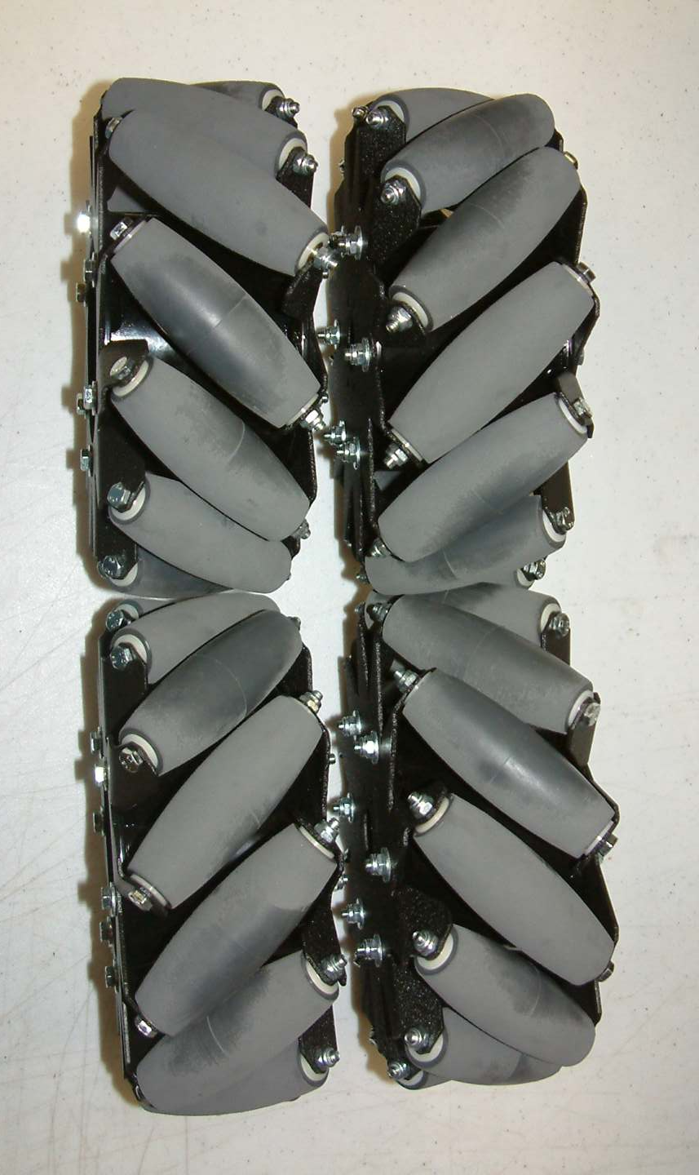
Omni: Mecanum Wheels
http://www.andymark.biz/mecanumwheels.html

Slide 26
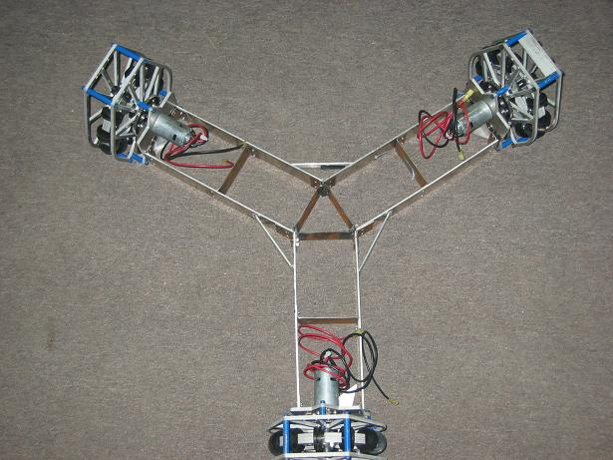
Omni: Holonomic / Killough
4-wheel drive needs square base for appropriate vector addition
Pros (+)
Turns around Center of robot
No complicated steering methods
Simultaneously used 2D motion and rotation
Maneuverability
Truly Any Direction of Motion
COTS parts
Cons (-)
Requires 3-4 independently powered motors
Weight
Cost
Programming Skill Necessary
NO Brake
Minimum Pushing Power
Teeth Chattering (unless dualies)
Climbing
Drifting (Weight Distribution)
3-wheel drive needs separated 120 degrees for appropriate vector addition

Slide 27
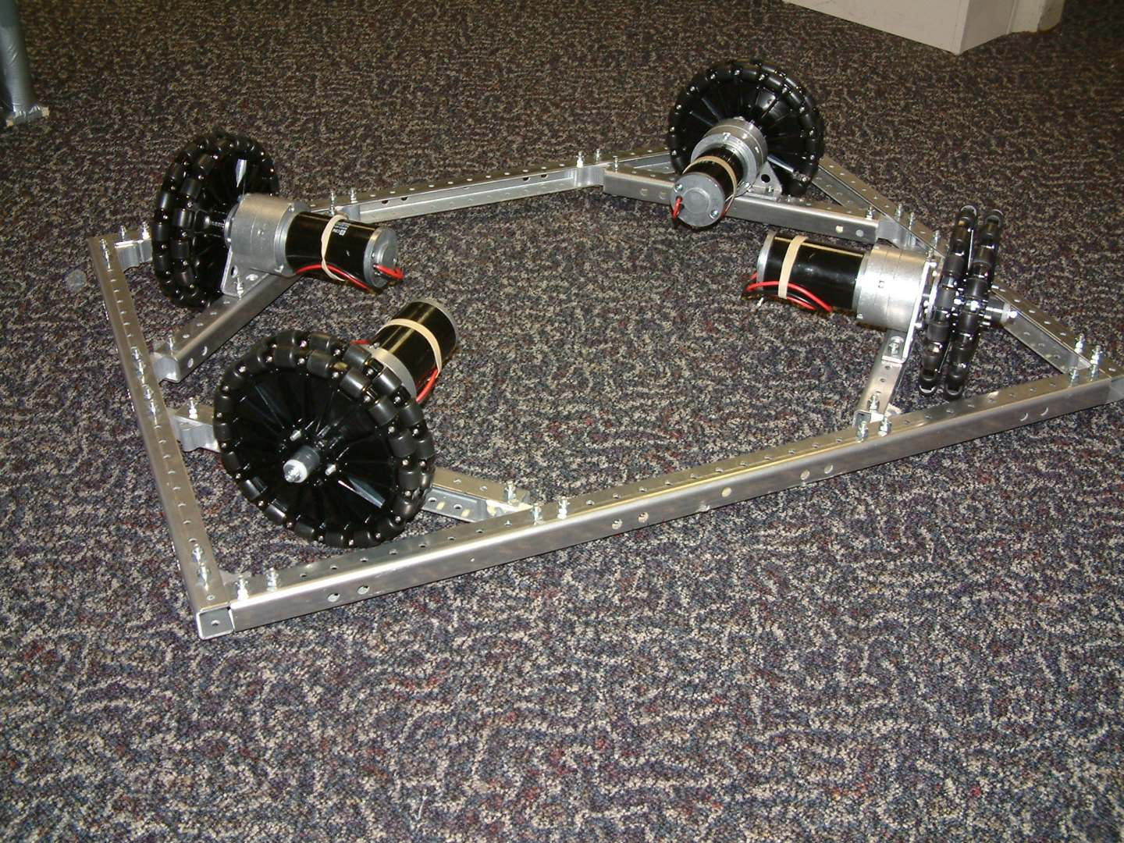
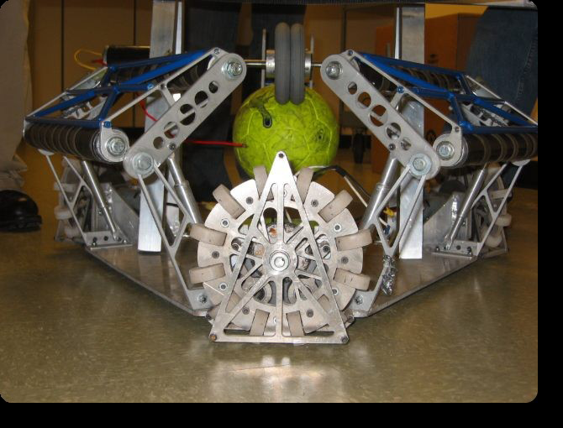
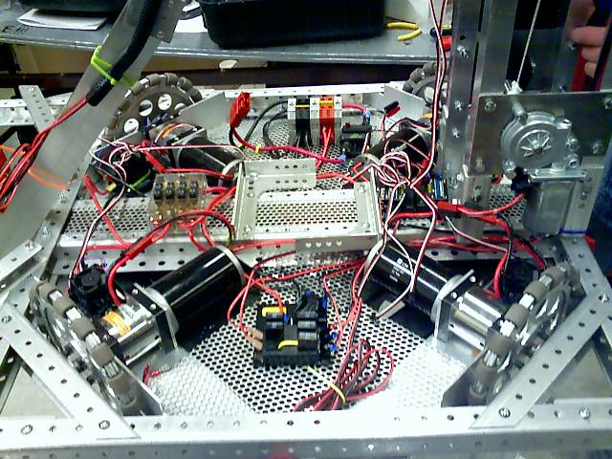
Omni: Holonomic Examples

Slide 28
Omni: Holonomic Drive Example
http://www.youtube.com/watch?v=03c3YuflQl4

Slide 29
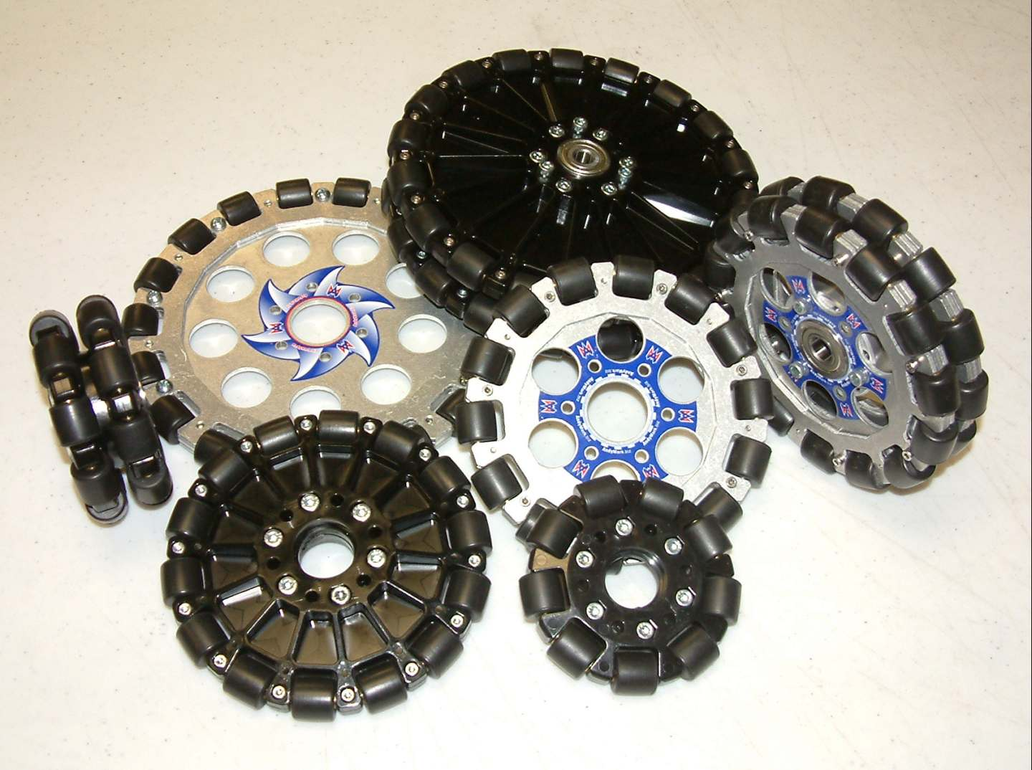
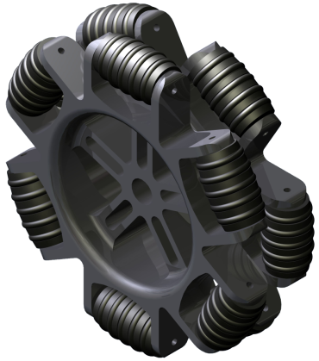
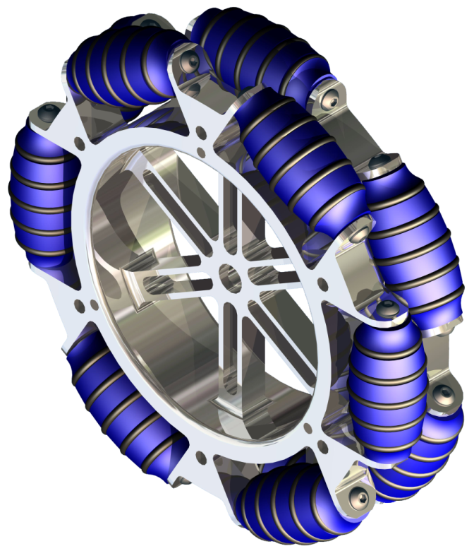
Omni: Holonomic/Omni Wheels
http://www.andymark.biz/omniwheels.html
Custom (1764)

Slide 30
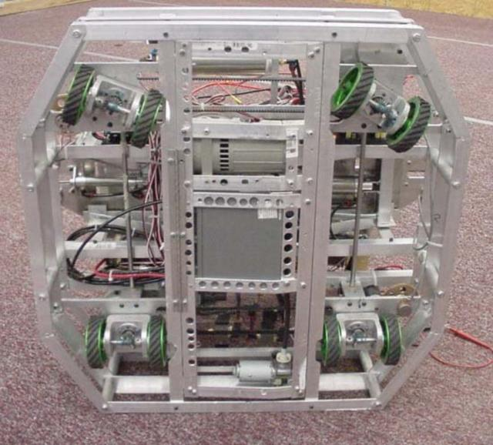
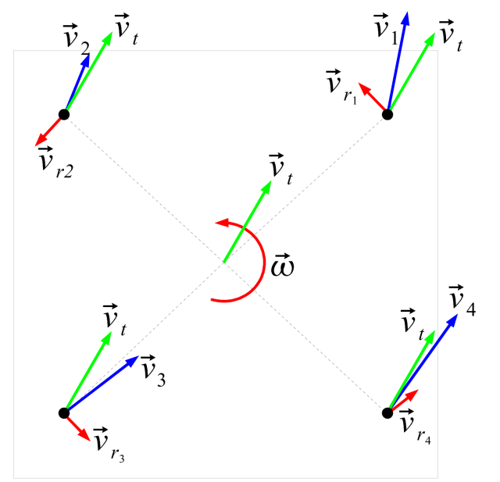
Omni: Sweve/Crab
All traction Wheels.
Each wheel rotates independently for steering
Pros (+)
Maneuverability
No Traction Loss
Simple wheels
Ability to hold/push
NEW!: COTS
Cons (-)
Mechanically Complex
Weight
Programming
Control and Drivability
Wheel turning delay

Slide 31
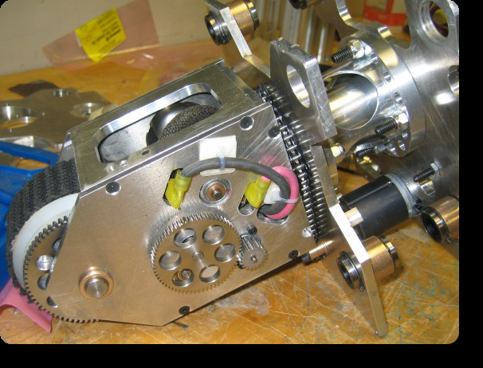
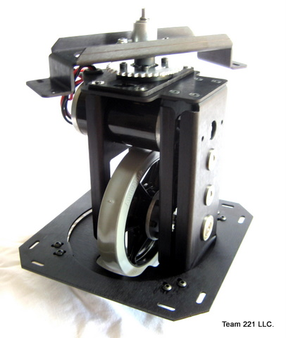
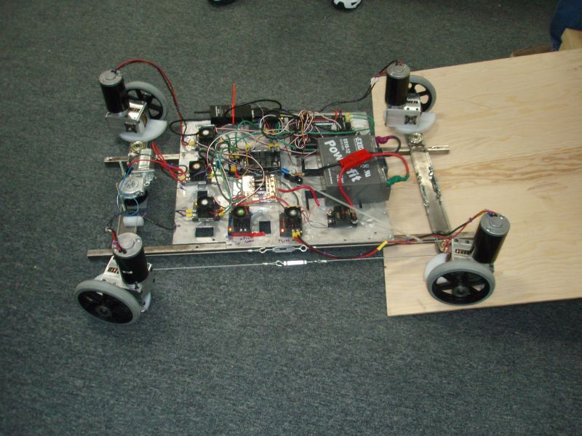
Omni: Swerve/Crab Exampe
Available at AndyMark.biz

Slide 32
Omni: Swerve/Crab Example
http://www.youtube.com/watch?v=ax_dtCUUKVU

Slide 33
Other Drive Systems
N Wheel Drive (More than 6)
Not much better driving than 6 wheel Drive
Improves climbing, but adds a lot of weight
3 Wheel Drive
Atypical – Therefore time intensive
Team 16 – Bomb Squad
Lighter than 4 wheel drive
Ball Drive
Rack and Pinion / Car Steering

Slide 34
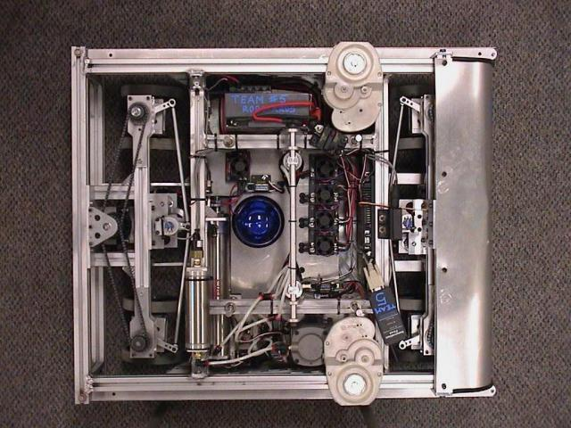
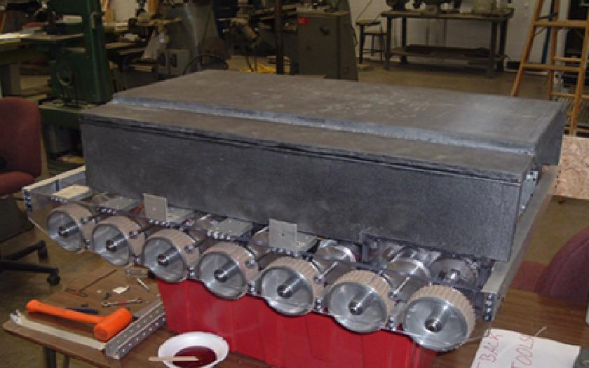
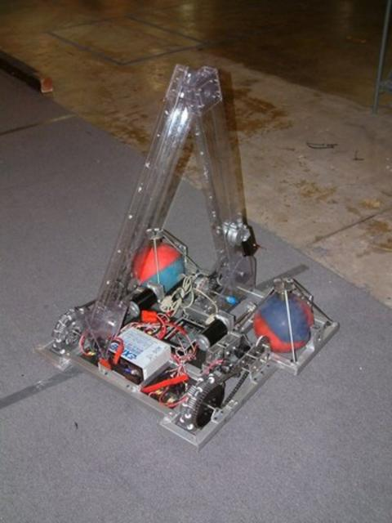
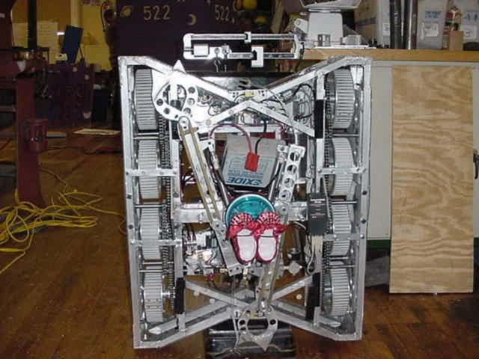
Other Drives: Examples

Slide 35
TRACTION

Slide 36
Coefficient of Friction
Coefficient of Friction is Dependent on:
Materials of the robot wheels/belts
Shape of robot wheels/belts
Materials on the floor surface
Surface Conditions

Slide 37
Materials of the robot wheels/belts
High Friction Coefficient:
Soft Materials
“Spongy” Materials
“Sticky” Materials
Low Friction Coefficient:
Hard Materials
Smooth Materials
Shiny Materials
It is often the case that “good” materials wear out much faster than “bad” materials - don’t pick a material that is TOO good!

Slide 38
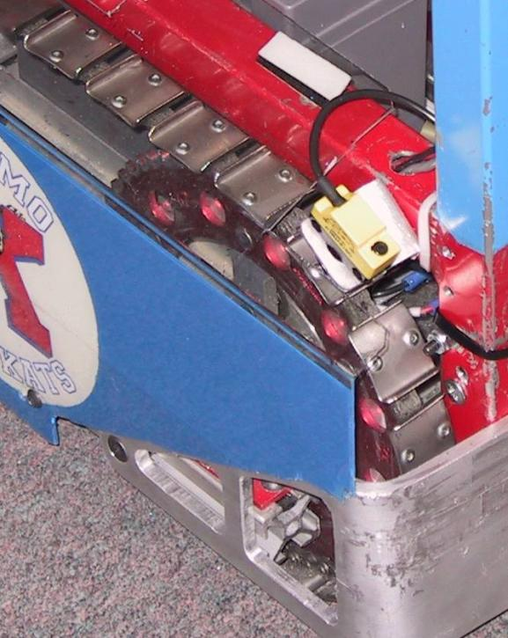
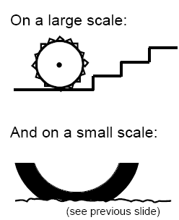
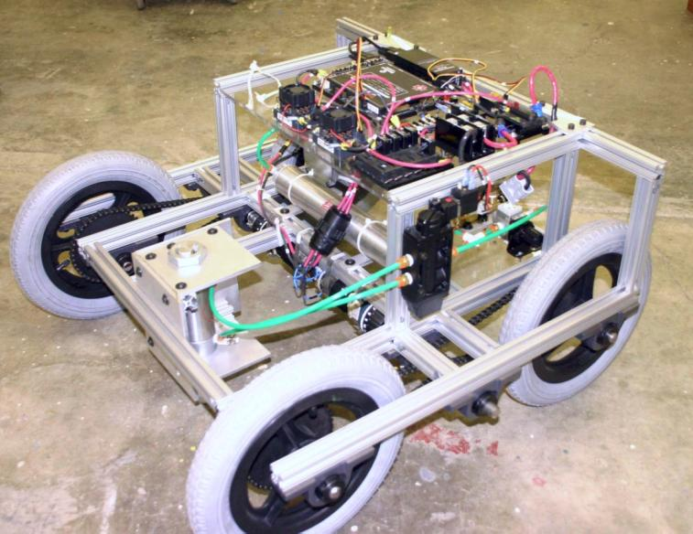
Shape of robot wheels/belts
Shape of wheel wants to “interlock” with the floor surface.

Slide 39
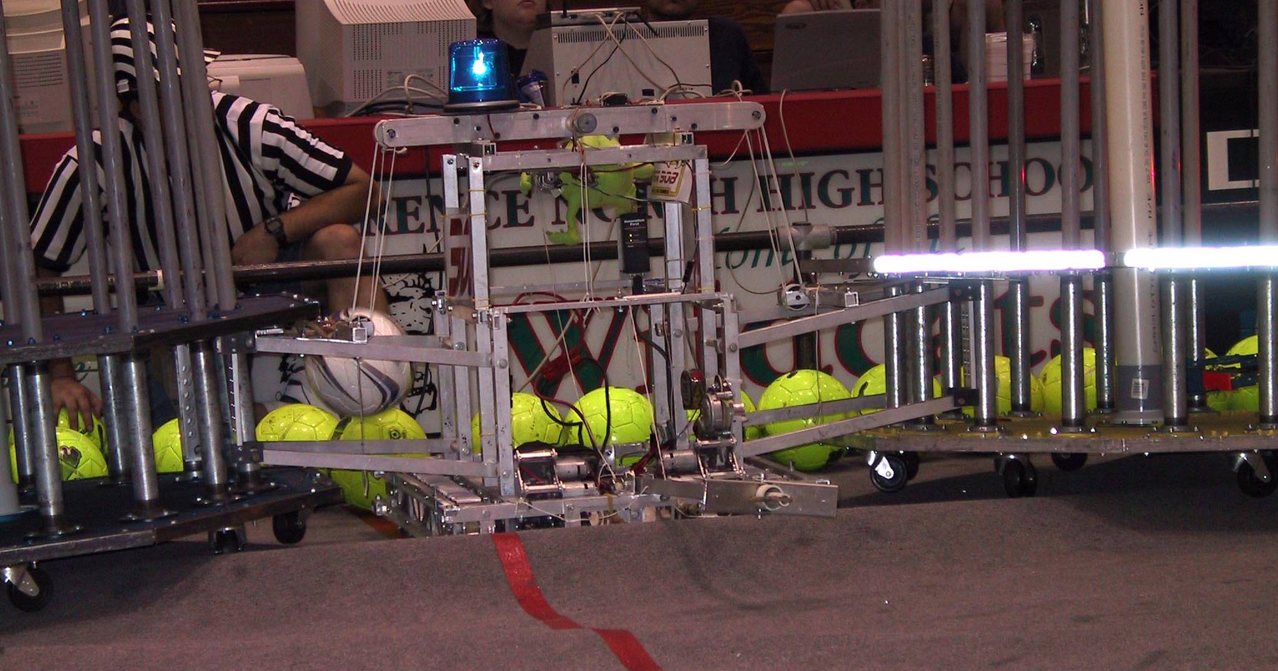
Materials on the floor surface
This is NOT up to you.
Know what surfaces you are running on:
Carpet,
“Regolith”
Aluminum Diamond Plate
Other
Follow rules about material contact
Too Much TRACTION for surface

Slide 40
Surface Conditions
Surface Conditions
In some cases this will be up to you
Good:
Clean Surfaces
“Tacky” Surfaces
Bad
Dirty Surfaces
Oily Surfaces
Don’t be too dependent on the surface condition since you can’t control it.
BUT… Don’t forget to clean your wheels

Slide 41
Traction Basics Terminology
maximum
tractive
force
Coefficient
of friction
x
Normal Force
(Weight)
torque
turning the
wheel
=
weight
tractive
force
normal
force
The coefficient of friction for any given contact with the floor, multiplied by the normal force, equals the maximum tractive force can be applied at the contact area.
Source: Paul Copioli, Ford Motor Company, #217

Slide 42
Traction Fundamentals “Normal Force”
weight
front
normal
force
(rear)
normal
force
(front)
The normal force is the force that the wheels exert on the floor, and is equal and opposite to the force the floor exerts on the wheels. In the simplest case, this is dependent on the weight of the robot. The normal force is divided among the robot features in contact with the ground. Therefore: Adding more wheels DOES NOT add more traction -
Source: Paul Copioli, Ford Motor Company, #217

Slide 43
Traction Fundamentals “Weight Distribution”
more weight in back
due to battery and
motors
less weight in front
due to fewer parts
in this area
EXAMPLE
ONLY
front
more
normal
force
less
normal
force
The weight of the robot is not equally distributed among all the contacts with the floor. Weight distribution is dependent on where the parts are in the robot. This affects the normal force at each wheel.
Source: Paul Copioli, Ford Motor Company, #217

Slide 44
Weight Distribution is Not Constant
arm position in
rear makes the weight
shift to the rear
arm position in front
makes the weight
shift to the front
EXAMPLE
ONLY
front
normal
force
(rear)
normal
force (front)
Source: Paul Copioli, Ford Motor Company, #217

Slide 45
POWER and Power Transmission

Slide 46
How Fast?
Under 4 ft/s – Slow. Great pushing power if enough traction.
No need to go slower than the point that the wheels loose traction
5-7 ft/s – Medium speed and power. Typical of a single speed FRC robot
8-12 ft/s – Fast. Low pushing force
Over 13ft/sec – Crazy. Hard to control, blazingly fast, no pushing power.
Remember, many motors draw 60A+ at stall but our breakers trip at 40A!

Slide 47
Power
Motors give us the power we need to make things move.
Adding power to a drive train increases the rate at which we can move a given load or increases the load we can move at a given rate
Drive trains are typically not “power-limited”
Coefficient of friction limits maximum force of friction because of robot weight limit.
Shaving off .1 sec. on your ¼-mile time is meaningless on a 50 ft. field.

Slide 48
MORE Power
Practical Benefits of Additional Motors
Cooler motors
Decreased current draw; lower chance of tripping breakers
Redundancy
Lower center of gravity
Drawbacks
Heavier
Useful motors unavailable for other mechanisms

Slide 49
Power Transmission
Method by which power is turned into traction.
Most important consideration in drive design
Fortunately, there’s a lot of knowledge about what works well
Roller Chain and Sprockets
Timing Belt
Gearing
Spur
Worm
Friction Belt

Slide 50
Power Transmission: Chain
#25 (1/4”) and #35 (3/8”) most commonly used in FRC applications
#35 is more forgiving of misalignment; heavier
#25 can fail under shock loading, but rarely otherwise
95-98% efficient
Proper tension is a necessity
1:5 reduction is about the largest single-stage ratio you can expect

Slide 51
Power Transmission: Timing Belt
A variety of pitches available
About as efficient as chain
Frequently used simultaneously as a traction device
Treaded robots are susceptible to failure by side-loading while turning
Comparatively expensive
Sold in custom and stock length – breaks in the belt cannot usually be repaired

Slide 52
Power Transmission: Gearing
Gearing is used most frequently “high up” in the drive train
COTS gearboxes available widely and cheaply
See previous slides
Driving wheels directly with gearing probably requires machining resources
Spur Gears
Most common gearing we see in FRC; Toughboxes, NBD, Shifters, Planetary Gearsets
95-98% efficient PER STAGE
Again, expect useful single-stage reduction of about 1:5 or less

Slide 53
Power Transmission: Gearing
Worm Gears
Useful for very high, single-stage reductions (1:100)
Difficult to backdrive
Efficiency varies based upon design – anywhere from 40% to 80%
Design must compensate for high axial thrust loading

Slide 54
Power Transmission: Friction Belt
Great for low-friction applications or as a clutch
Apparently easier to work with, but requires high tension to operate properly
Usually not useful for drive train applications

Slide 55
TRANSMISSIONS

Slide 56
Transmissions / Gearbox
Transmission Goal:
Translate Motor Motion and Power into Robot Motivation
Motor:
Speed (RPMs)
Torque (ft-lbs or Nm)
Robot
Speed (feet per second [fps])
Weight

Slide 57
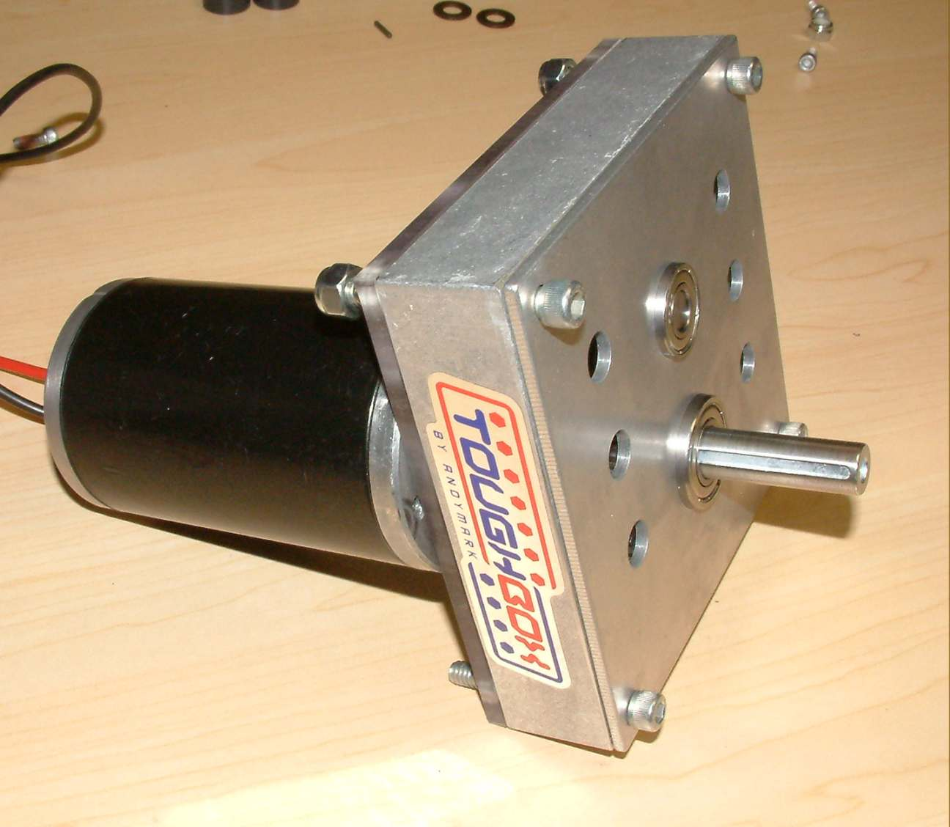
Transmissions – AM ToughBox
AndyMark ToughBox
Standard KOP
2 CIMs or 2 FP with AM Planetary GearBox
Overall Ratio: 12.75:1
Gear type: spur gears
Weight: 2.5 pounds
Options
Ratio 1: 5.95:1
Ratio 2: 8.45:1
Weight Reduction
$88.00
http://www.andymark.biz/am-0145.html

Slide 58
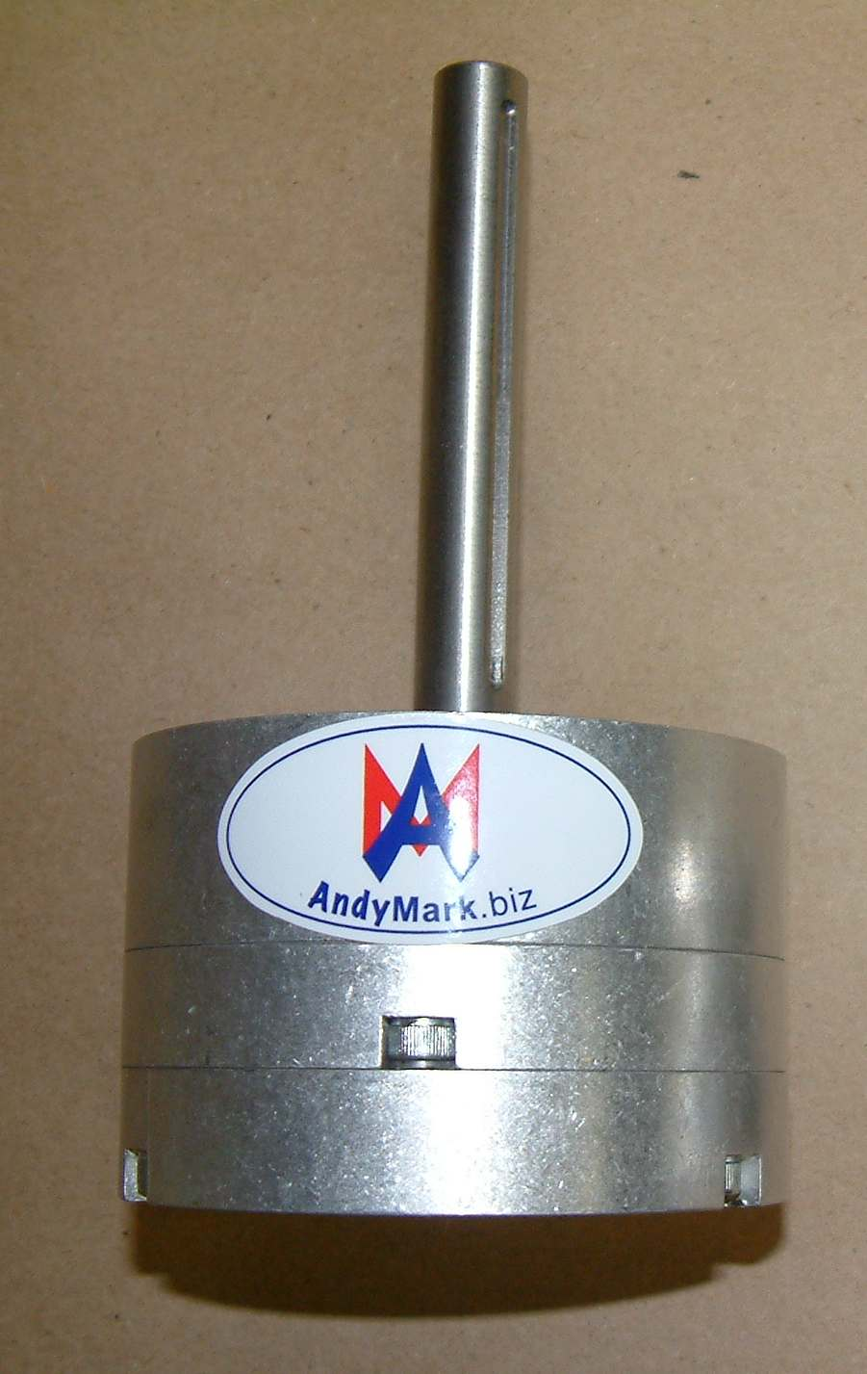
Tranmissions – AM GEM500
GEM500 Gearbox
Planetary Style
1 CIM or 1 FP with Planetary Gearbox
Weight: 2.4 pounds
Output Shaft: 0.50”
Gear Ratios
Each stage has a ratio of 3.67:1.
Base Stage: 3.67:1
Two Stages: 13.5:1
Three Stages: 45.4:1
Four Stages: 181.4:1
$120.00

Slide 59
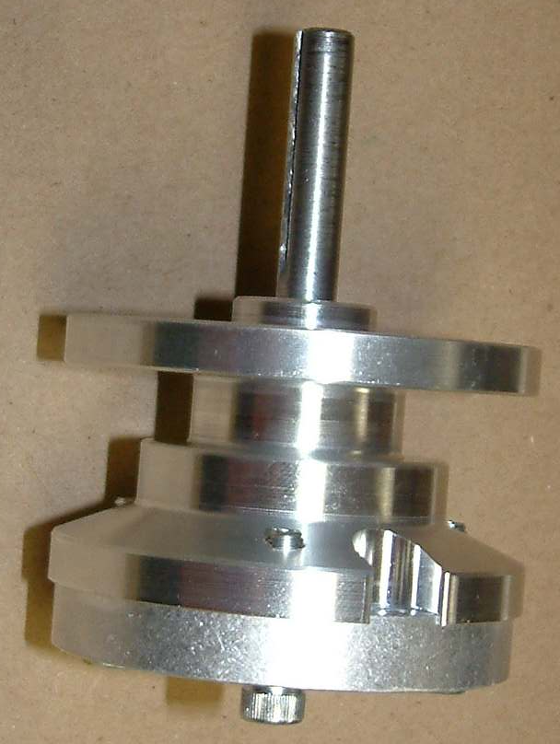
Transmissions – AM Planetary
AM Planetary Gearbox AM-0002
Same Mounting and Output as the CIM!
For Fischer Price Mabuchi Motor
Accepts Globe & CIM w/Alterations
Weight = 0.9 lbs
Gear Reduction
Single Stage: 3.67: 1
Matches CIM… sort of
$88.00
With FP Installed: $117.00

Slide 60
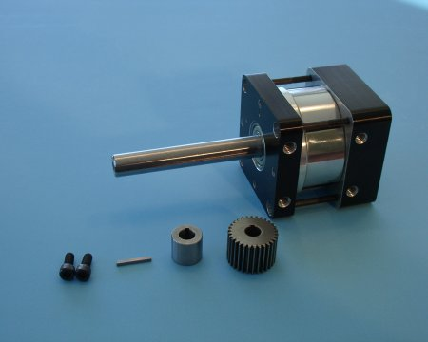
Transmissions – BB P80 Series
BaneBots Planetary GearBox
Max Torque: 85ft-lbs
Available with or without motor
Gear Ratios
3:1 4: 1 9:1
12:1 16:1 27.1
36:1 48:1 64:1
81:1 108:1 144:1
192:1 256:1
$79.50 - $157.25

Slide 61
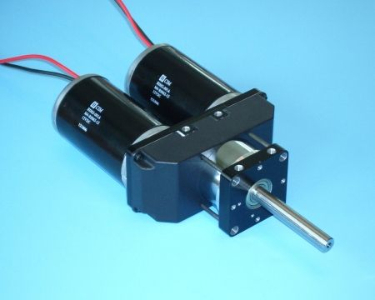
Transmissions – BB P80 Dual
BaneBots Planetary GearBox
Max Torque: 85ft-lbs
Available with or without motor
Gear Ratios
4: 1 12:1 16:1
36:1 48:1 64:1
108:1 144:1 192:1
256:1
$124.75 - $199.75

Slide 62
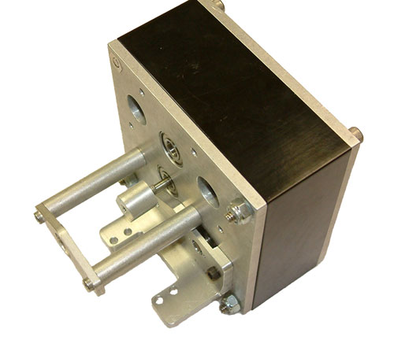
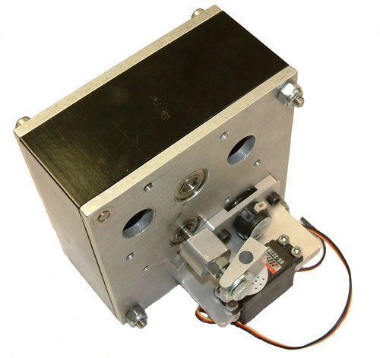
Shiftable Transmission: AndyMark (AM)
Super Shifter am-0114
Available from AndyMark
www.andymark.biz
Purchased as set
Cost with Shipping
$360.90 EACH

Slide 63
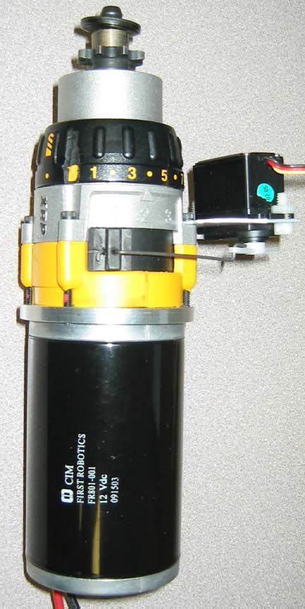
Shifting Transmissions: NDB
Nothing But DeWalts
Team Modifies DeWalt XRP Drill
Purchase Pieces and Assemble
COST with Shipping:
$108.32 EACH!

Slide 64
Compare SS and NBD
Super Shifter AM
Nothing but dewalts
2 speed
Interface with
2 CIMs
2 AM Planetary Gearbox
Gear Reduction
67:1
17:1
Shifts on the fly
Servo
Pneumatic (Bimba series)
3 speed
Interface with 1:
Chiaphua (CIM)
Fischer Price
Globe Motor
Gear Reduction
47:1, 15:1, 12:1
Shifts on the fly
Servo only

Slide 65
Compare SS and NBD
Super Shifter AM
Nothing but dewalts
Weight: 3.6 lbs w/o motors
Size with:
CIM: 6” x 4.25” x 8.216
FP Mod: 6” x 4.25” x 10.344”
Comes with:
Optical Encoder
Servo Shifter
12 tooth #35 chain output sprockets per shaft
Optional to purchase
4:1 high/low ratio
Weight: < 2 lbs w/o motors
Size
CIM: 9.5” x 4” x 3”
Other: Varies on use
Does not come with
Servo
Servo Shifter
Encoder
Mounting plates

Slide 66
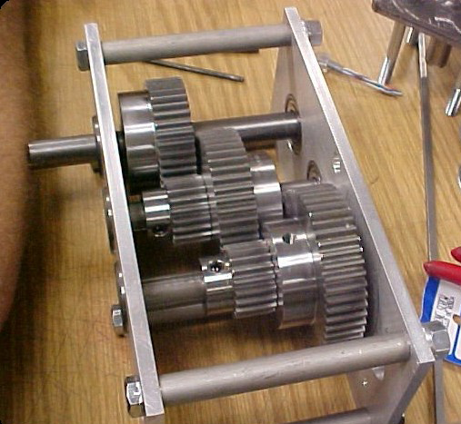
Custom Gearboxes
Many teams build their own gearboxes
Built to suit
Can be very rugged
Can include single or multiple motors
Easier to add custom and Advanced features
Shift, Encoders, Straffing, etc.

Slide 67
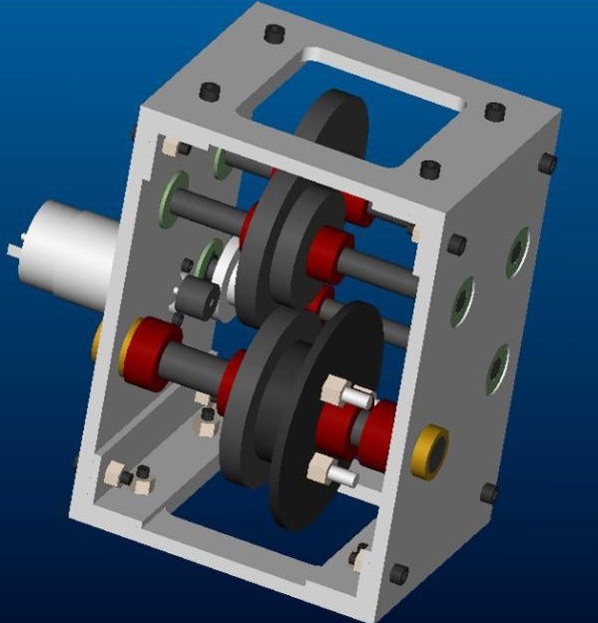
Basic Custom Gearbox
Two 1/4” aluminum plates to mount shafts, separated by either four posts or two more aluminum plates
Motor(s) bolted into back plate
Sprockets and chain to wheels

Slide 68






Basic Custom Gearbox: Power Transmisison
Keyways
Strong
Hard to machine Keyway
Pins
Easy to machine
Weaker
Set Screws
Avoid if possible
Loctite and Knurled if used
Bolts
Very effective for large gears/sprockets

Slide 69
PRACTICAL AND REALISTIC CONSIDERATIONS

Slide 70
Remember…
Most first teams overestimate their ability and underestimate reality.

Slide 71
Reality Check
Robot top speed will occur at approximately 80-85% of max speed.
Max speed CIM = 5600 rpms (NO LOAD)
Reality: 5600 x 0.85 = 4760 rpms
Friction is a two edged sword
Allows you to push/pull
Doesn’t allow you to turn
You CAN have too much of it!
Frequent for 4WD Systems

Slide 72
Tips and Good Practices
Most important consideration, bar none.
Three most important parts of a robot are, famously, “drive train, drive train and drive train.”
Good practices:
Support shafts in two places. No more, no less.
Reduces Friction
Can wear out faster and fail unexpectedly otherwise
Avoid long cantilevered loads
Avoid press fits and friction belting
Alignment, alignment, alignment!
Reduce or remove friction almost everywhere you can

Slide 73
Tips and Good Practices
You will probably fail at achieving 100% reliability
Good practices:
Design failure points into drive train and know where they are
Accessibility is paramount. You can’t fix what you can’t touch
Bring spare parts; especially for unique items such as gears, sprockets, transmissions, mounting hardware, etc.
Aim for maintenance and repair times of <4min.
TIMEOUTS!
Alignment, Alignment, Alignment….Alignment
Use lock washers, Nylock nuts or Loctite EVERYWHERE

Slide 74
Tips and Good Practices
Only at this stage should you consider advanced thingamajigs and dowhatsits that are tailored to the challenge at hand
Stairs, ramps, slippery surfaces, tugs-of-war
“Now that you’ve devised a fantastic system of linkages and cams to climb over that wall on the field, consider if it’d just be easier, cheaper, faster and lighter to drive around it.”

Slide 75
Credits
AndyMark, Inc.
BaneBots.com
FIRST Robotics Drive Systems; Andy Baker, President: AndyMark, Inc.
FIRST Robotics Drive Trains; Dale Yocum
FRC Drive Train Design and Implementation; Madison Krass and Fred Sayre, Team 448
Mobility: Waterloo Regional; Ian Makenzie
Robot Drive System Fundamentals – FRC Conference: Atlanta, GA 2007
Ken Patton (Team 65), Paul Copioli (Team 217)
www.chiefdelphi.com
www.chiefdelphi.com/forums/papers.php
http://www.firstroboticscanada.org/site/node/71

